Slide 1
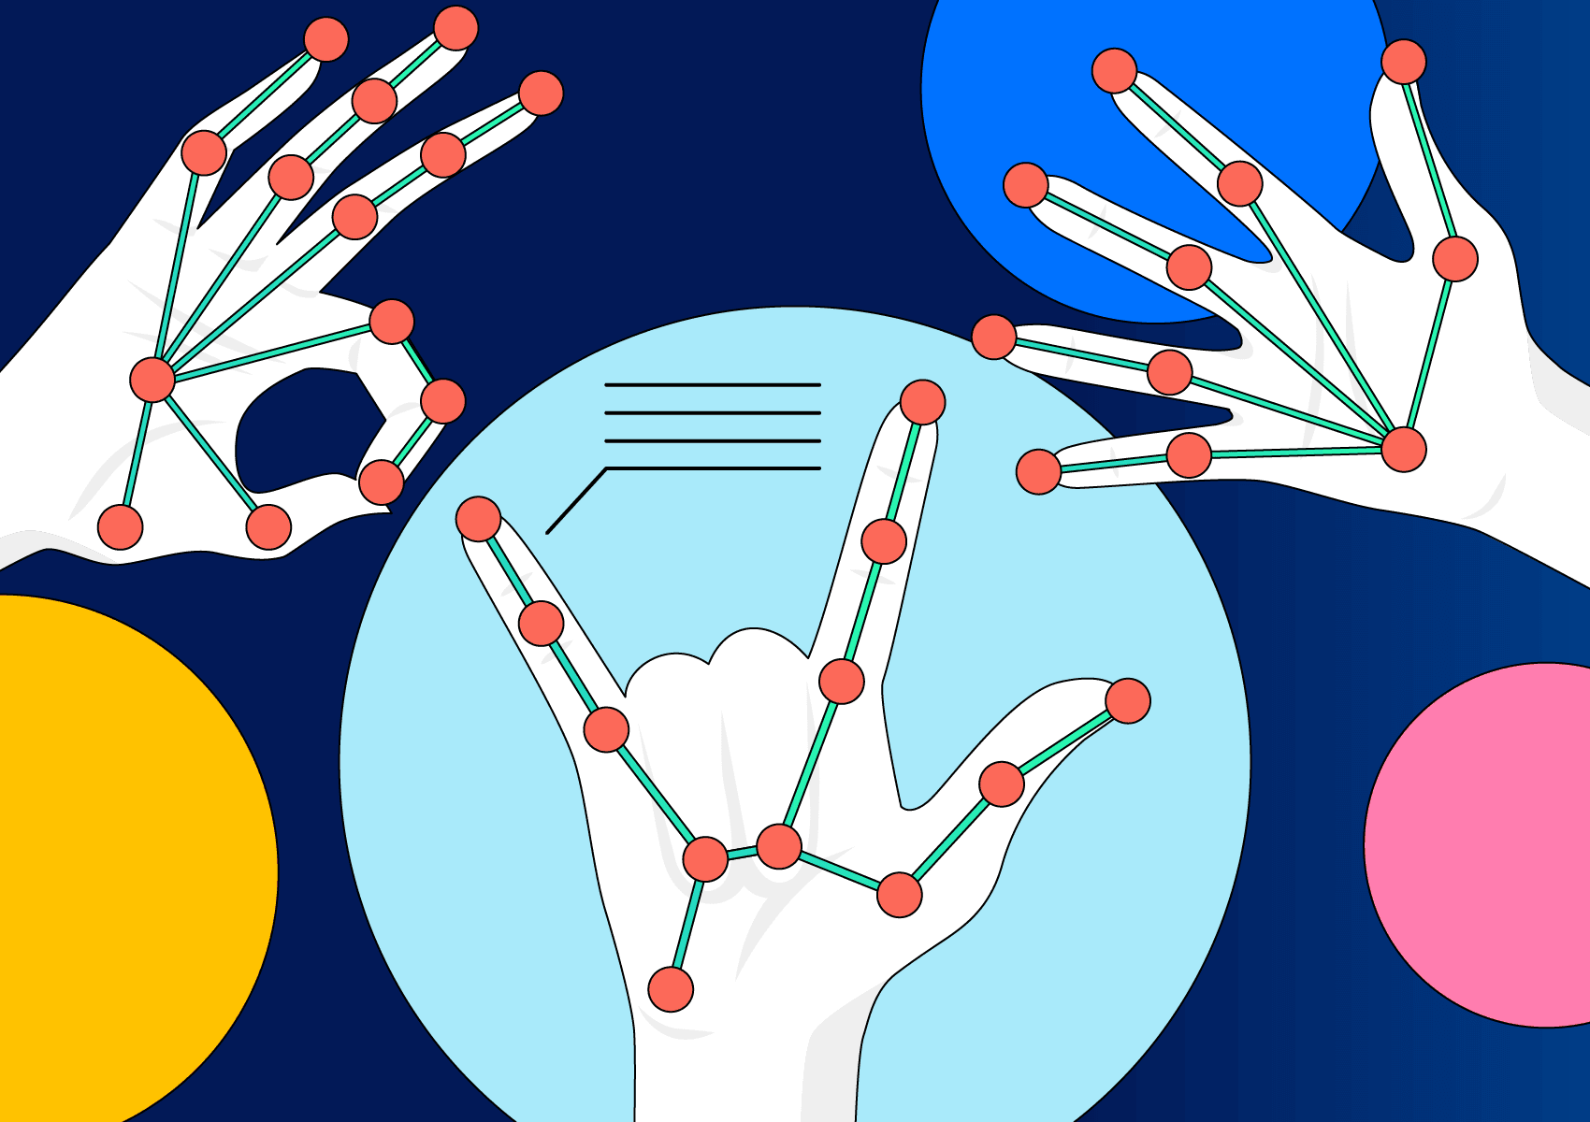
Hand Gesture Recognition Using CNN and Real-Time Detection
Popescu Matei Calin
Rus Alexandru

Slide 2
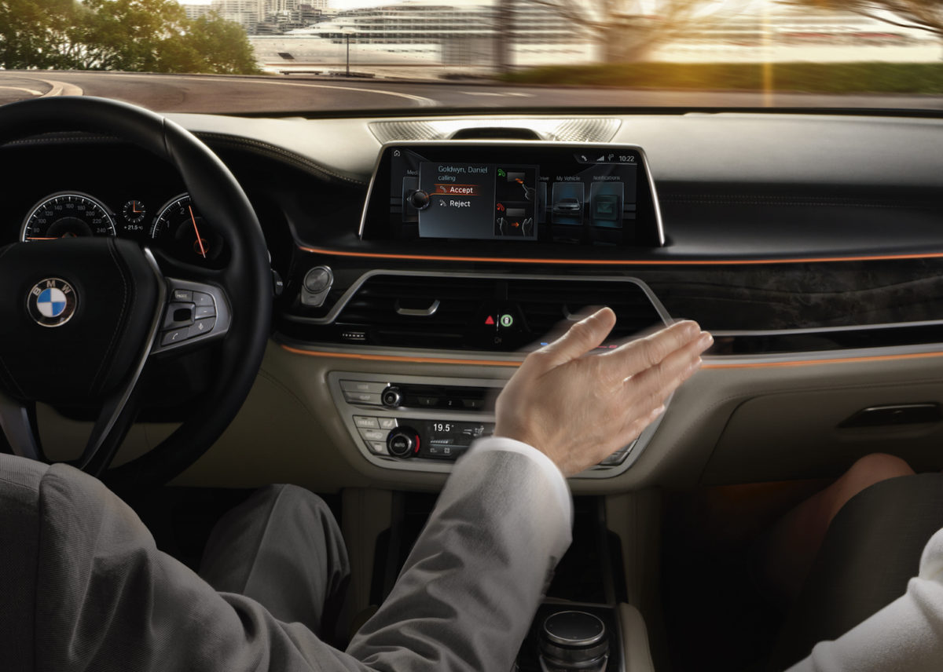
Why hand gesture recognition?
- Continuous Growth:
According to Market.us, The Global Gesture Recognition Market size is expected to be worth around USD 106.2 Bn by 2032 from USD 18.8 Bn in 2022, growing at a CAGR of 18.9% during the forecast period from 2023 to 2032.
- Widely Spread and Aplicability:
Healthcare: Surgeons use gestures to navigate medical images during surgery without physical contact.
Smart Homes: Control lights, appliances, and multimedia systems using simple hand gestures.
Automotive: Drivers adjust settings (e.g., volume, navigation) without taking hands off the wheel.

Slide 3
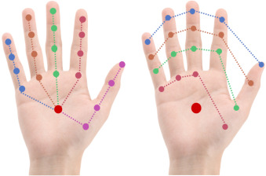
I. Overview
Purpose:
Integrates deep learning with real-time video processing
Design a robust gesture recognition model for real-time use.
Recognizes and maps 3 gestures to music player controls:
Palm/Fist → Play/Pause
Thumbsup → Next Song
Thumbsdown → Previous Song

Slide 4
II. Setup
Dataset:
1500 images per gesture, resized to 100 x 100, grayscale
Preprocessed to reduce noise and improve performance
Integration:
Real-time classification with OpenCV
Live to feedback on video feed
Model Architecture:
Convolutional Layers: Feature extraction.
Batch Normalization: Stabilizes training.
Pooling & Dropout Layers: Reduces overfitting.
Fully Connected Layers: Maps features to gestures.

Slide 5
III. Experimental Setup
Data Preprocessing -> Images resized, normalized, grayscale
Gesture Recognition Results:
90% validation accuracy after 10 epochs
Near-instantaneous real-time response
Test Conditions:
Well lit Room, Dim Lighting, Background Clutter
Other training methods:
MediaPipe for hand tracking + Pygame for audio playback
Uses MediaPipe to detect hands and extract 21 landamarks
Tracks fingers and analyses landmark positions

Slide 6
Demo
Thank you!
References:
Wikipedia contributors. "Gesture Recognition." Accessed January 21, 2025.
Mordor Intelligence. "Gesture Recognition Market - Growth, Trends, and Forecasts (2023 - 2028)." Accessed January 21, 2025.

